Slide 1

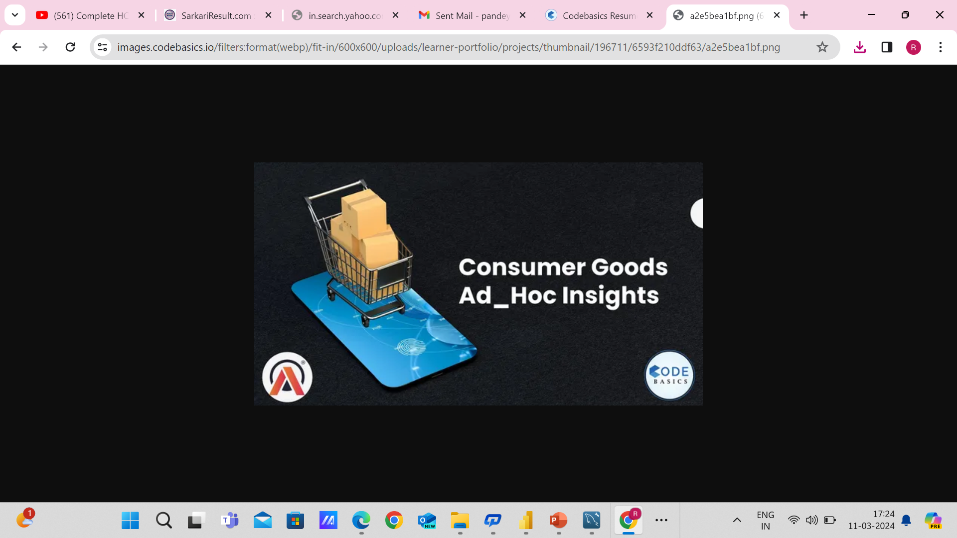



By: Ranjeev Pandey

Slide 2
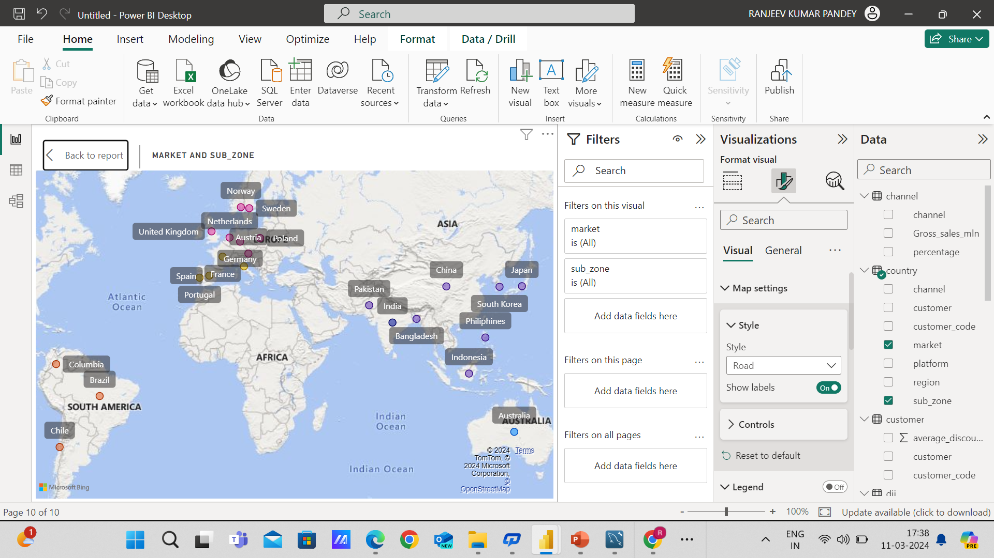
About the Company
Atliq Hardware (imaginary company) is one of the leading computer hardware producers in India and well expanded in other countries too. India as well as 26 other countries across the globe
Manufactures products under 3 major divisions i.e., Peripherals & Accessories, PC, Networking & Storage
We have a total of 74 Customers like Neptune, Sage, Leader, Vijay Sales, etc. across all markets/countries

Slide 3
About The Challenge
Atliq Hardware (imaginary company) is one of the leading computer hardware producers in India and well expanded in other countries too.
However, the management noticed that they do not get enough insights to make quick and smart data-informed decisions. They want to expand their data analytics team by adding several junior data analysts. Tony Sharma, their data analytics director wanted to hire someone who is good at both tech and soft skills. Hence, he decided to conduct a SQL challenge which will help him understand both the skills.

Slide 4
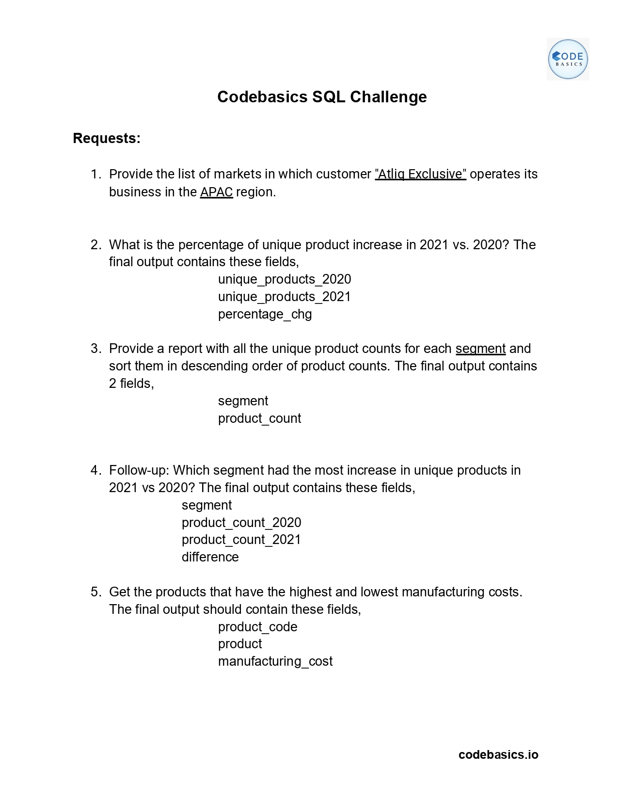
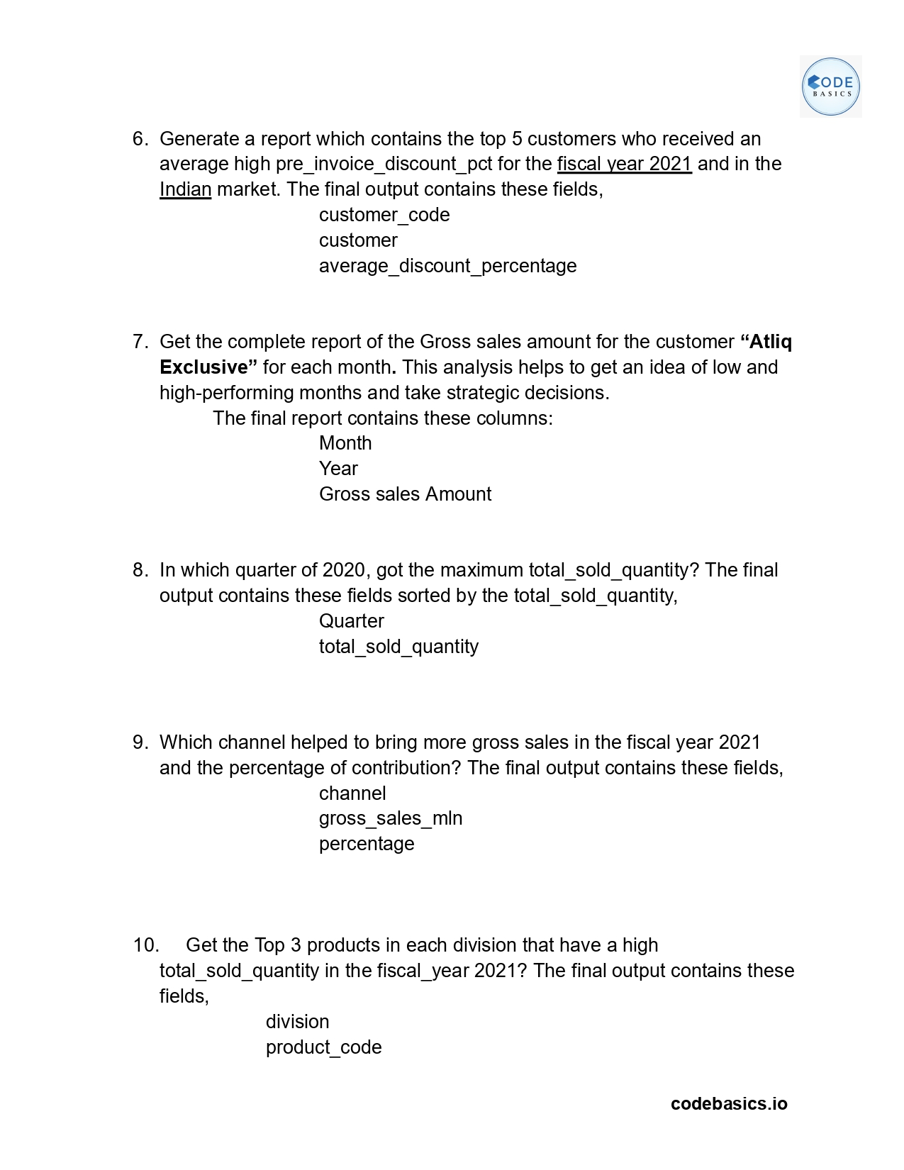

Slide 5
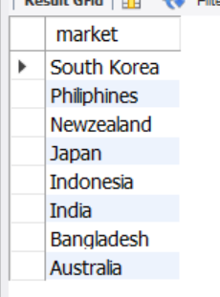
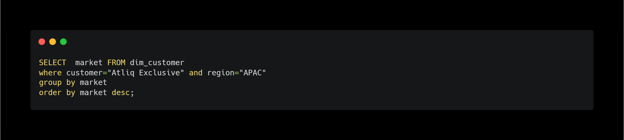
Provide the list of markets in which customer "Atliq Exclusive" operates its business in the APAC region.

Slide 6
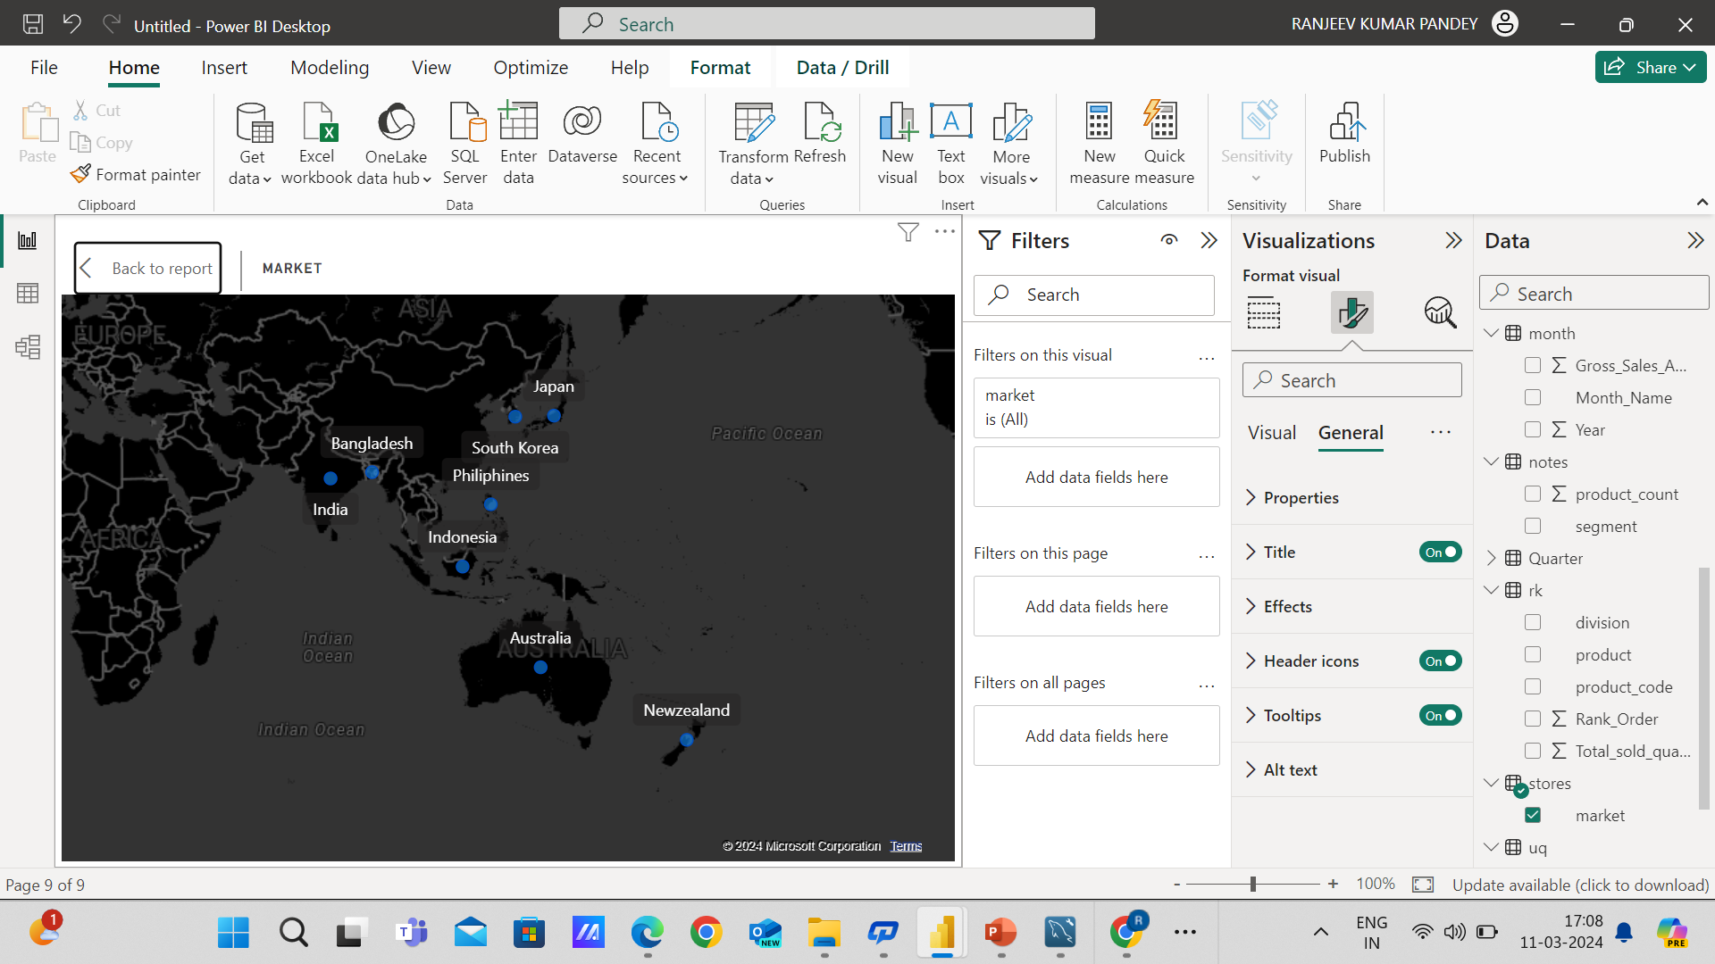

Slide 7
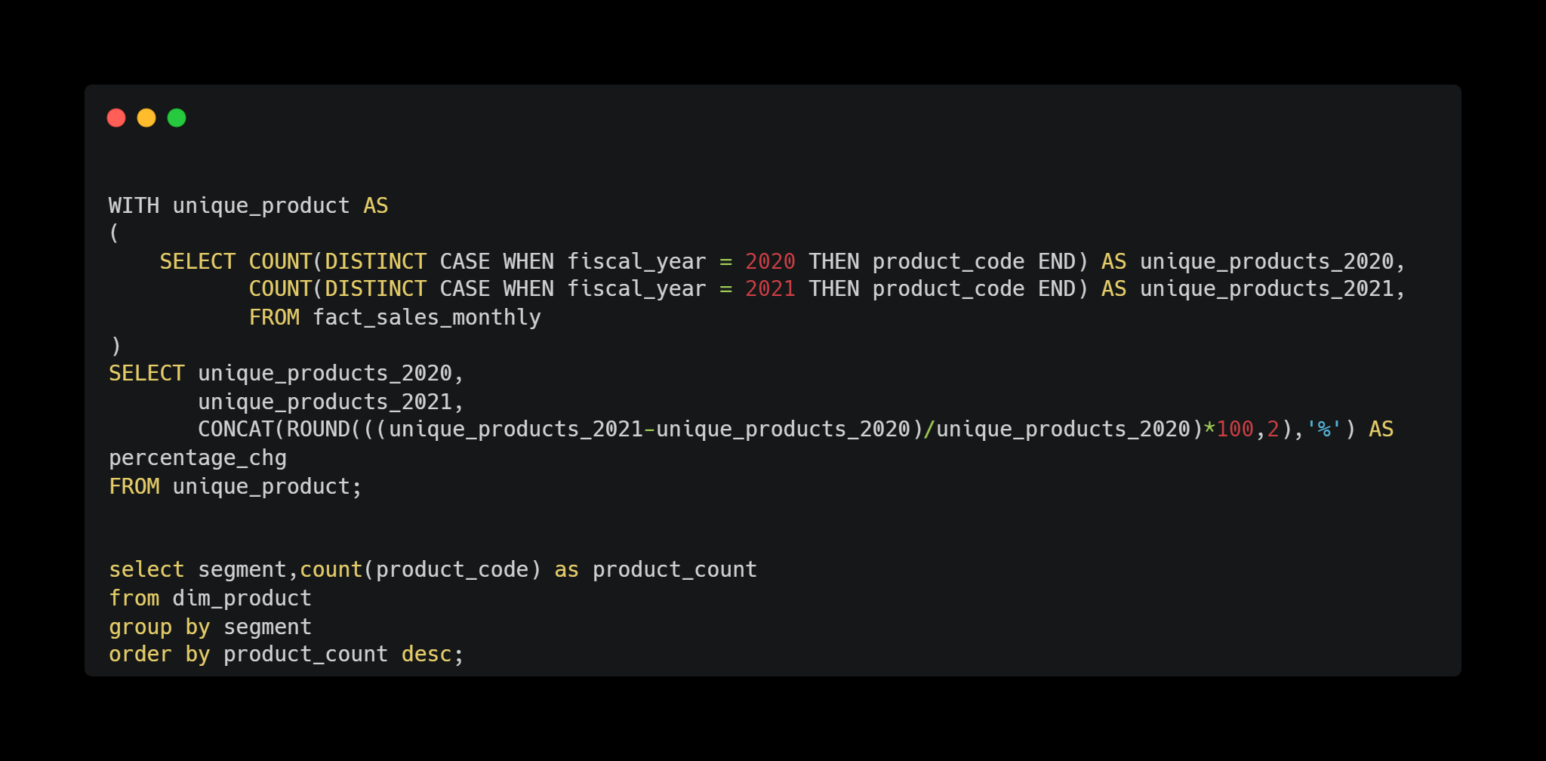
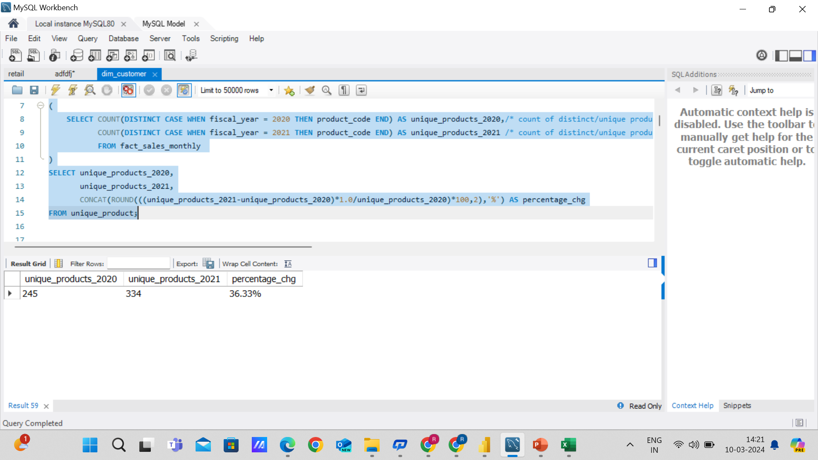
What is the percentage of unique product increase in 2021 vs. 2020? The final output contains these fields, unique_products_2020 unique_products_2021 percentage_chg

Slide 8
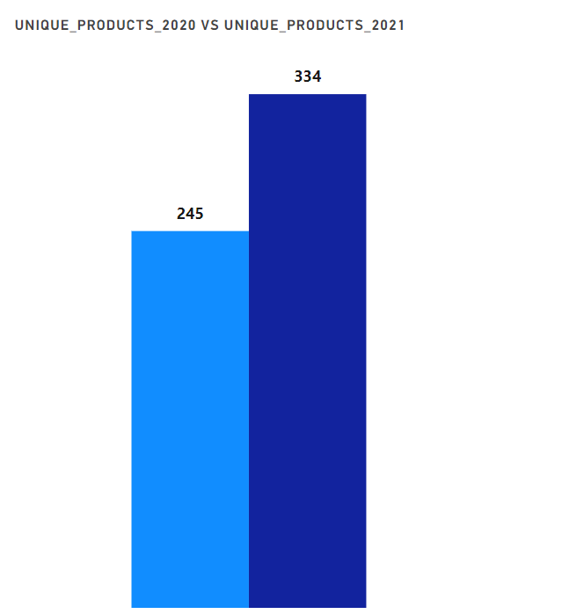
From the above graph we can see that Atliq Hardware has sold 245 units in 2020 and 334 units in 2021,With a 36.33% increase in new products.

Slide 9
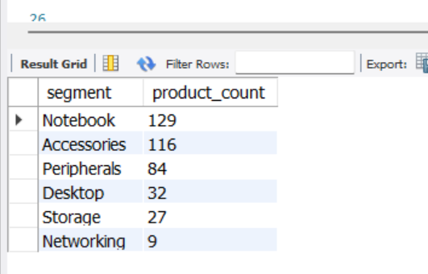
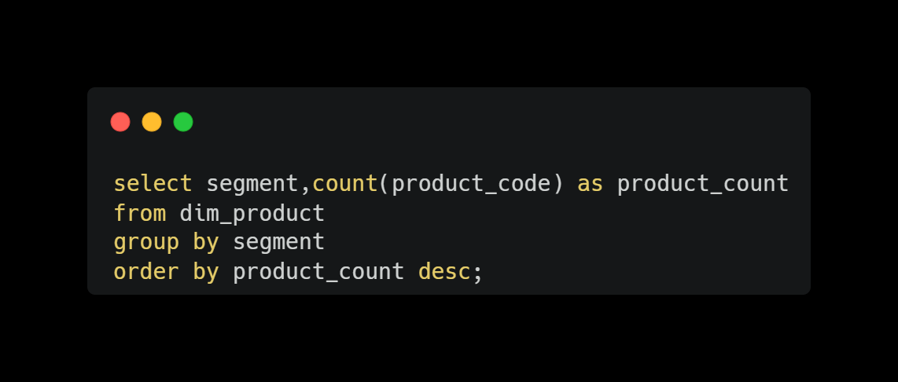
Provide a report with all the unique product counts for each segment and sort them in descending order of product counts. The final output contains 2 fields,
Segment
product_count

Slide 10
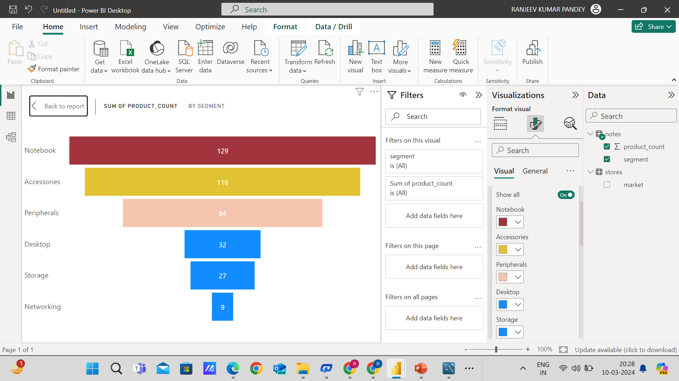
From the above, we can see that most of the products are in the segment of Notebook, Accessories,Peripherals and the least products are in the segment of Desktop,Storage, Networking

Slide 11
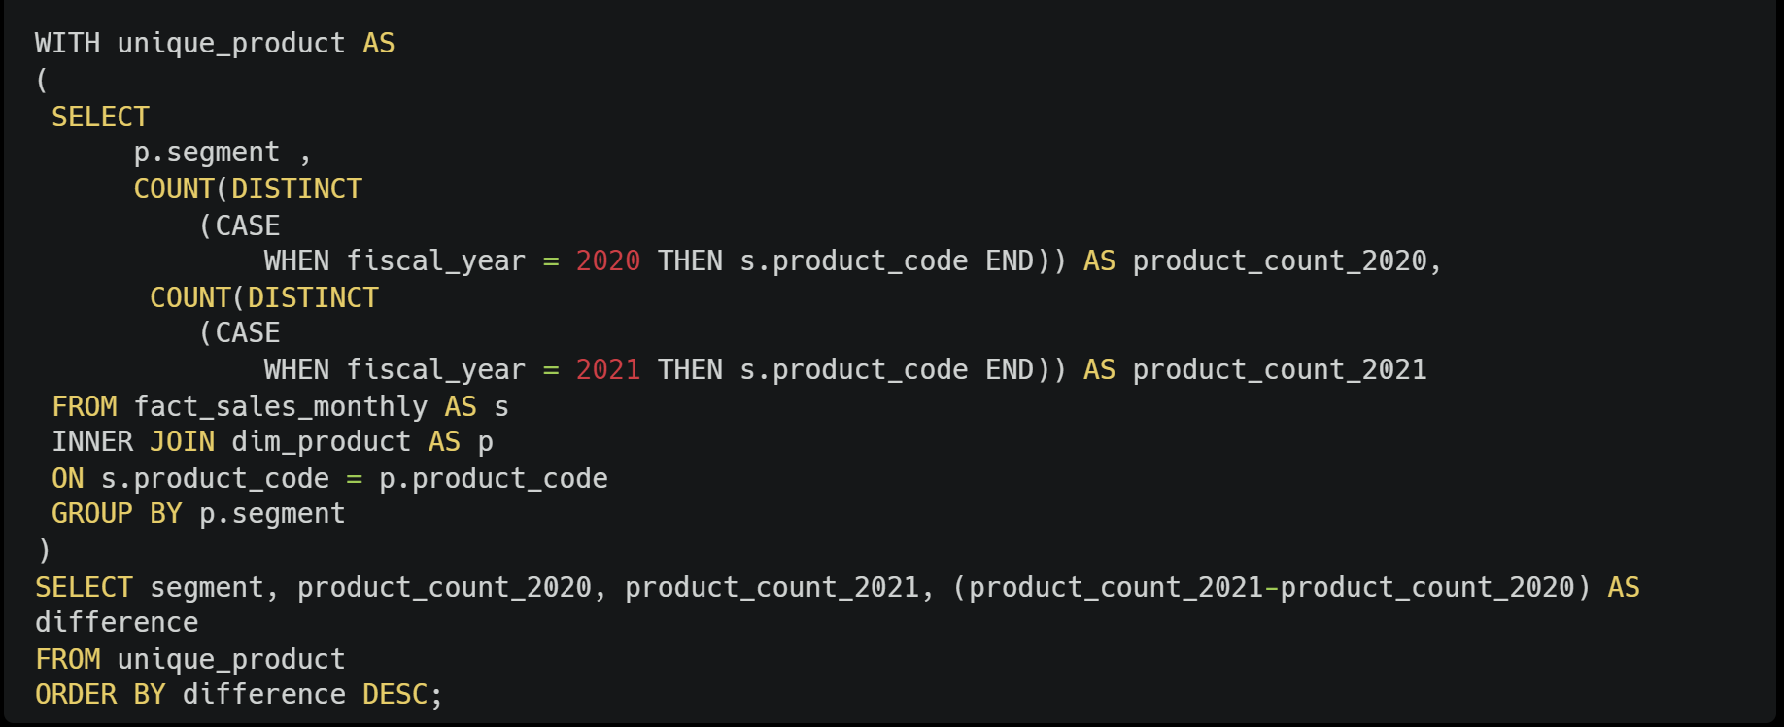
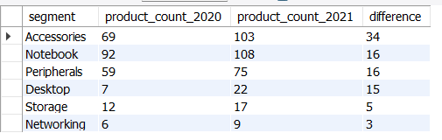
Follow-up: Which segment had the most increase in unique products in 2021 vs 2020? The final output contains these fields,
segment
product_count_2020
product_count_2021
difference

Slide 12
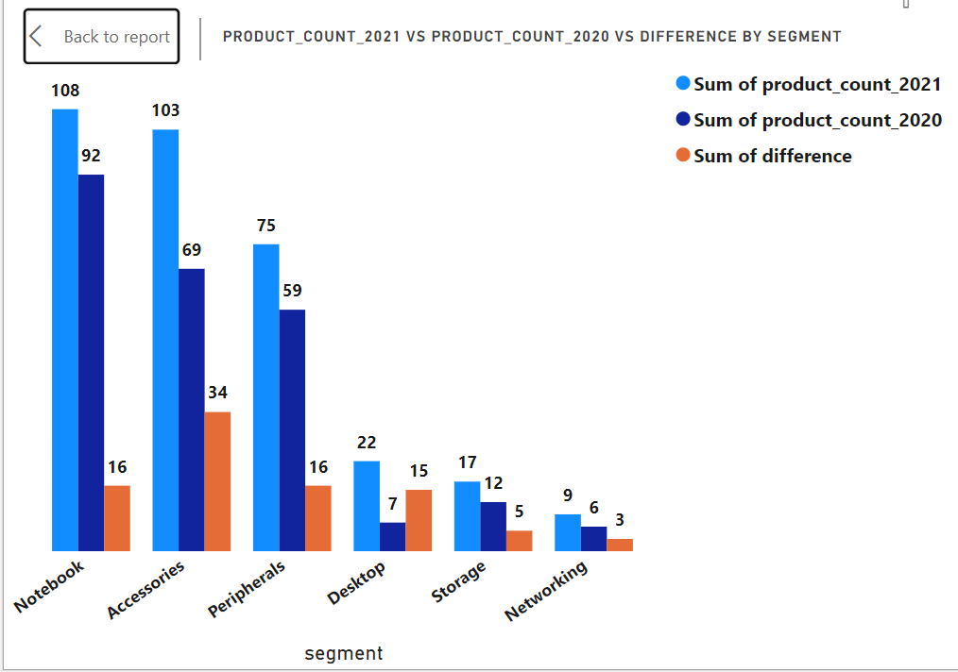
With the 34 new products, the Accessories segment tops the list
Notebook and Peripherals each have an increment of 16 new unique products
Desktop segment is increasing unique products from 7 to 22
Networking segment is at the bottom with 3 new products introduced since 2020

Slide 13
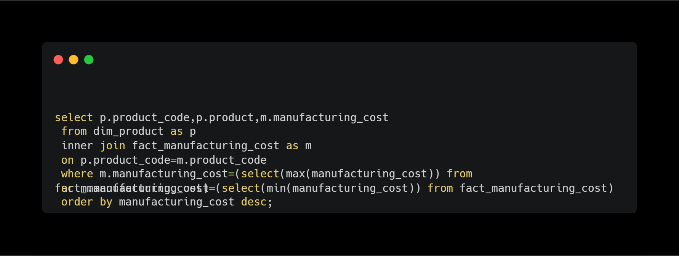
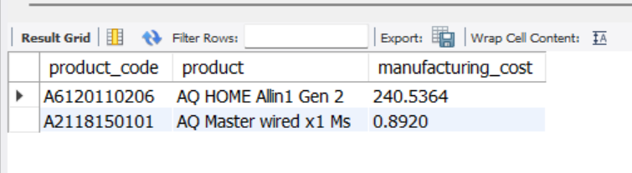
. Get the products that have the highest and lowest manufacturing costs. The final output should contain these fields,
product_code
product
manufacturing_cost

Slide 14
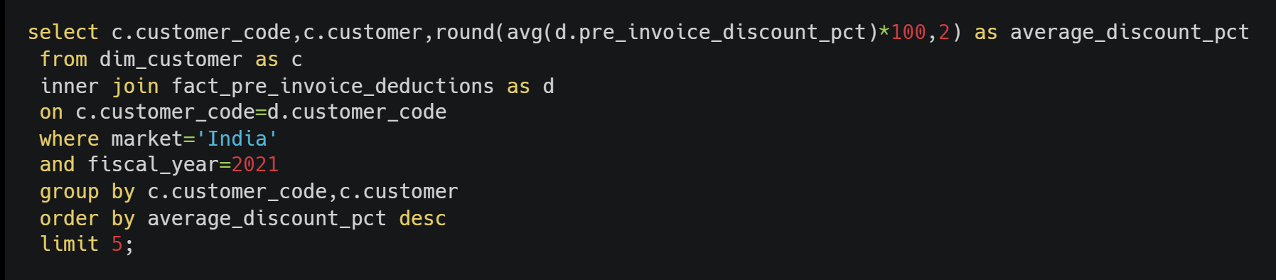
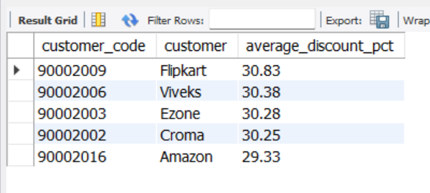
Generate a report which contains the top 5 customers who received an average high pre_invoice_discount_pct for the fiscal year 2021 and in the Indian market. The final output contains these fields,
customer_code
Customer
average_discount_percentage

Slide 15
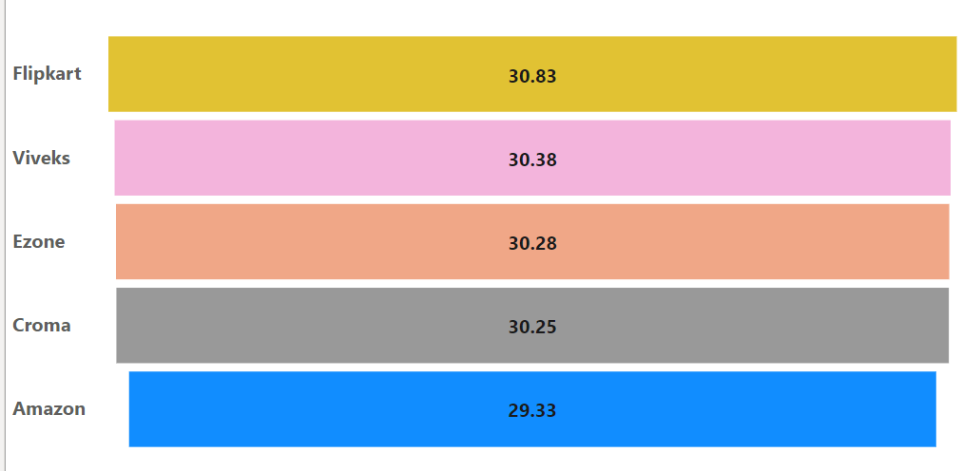
Flipkart tops the list received with the highest pre-invoice discount percentage i.e., 30.83%.
Amazon is at Bottom in the list with the lowest pre-invoice discount percentage i.e.;29.33

Slide 16
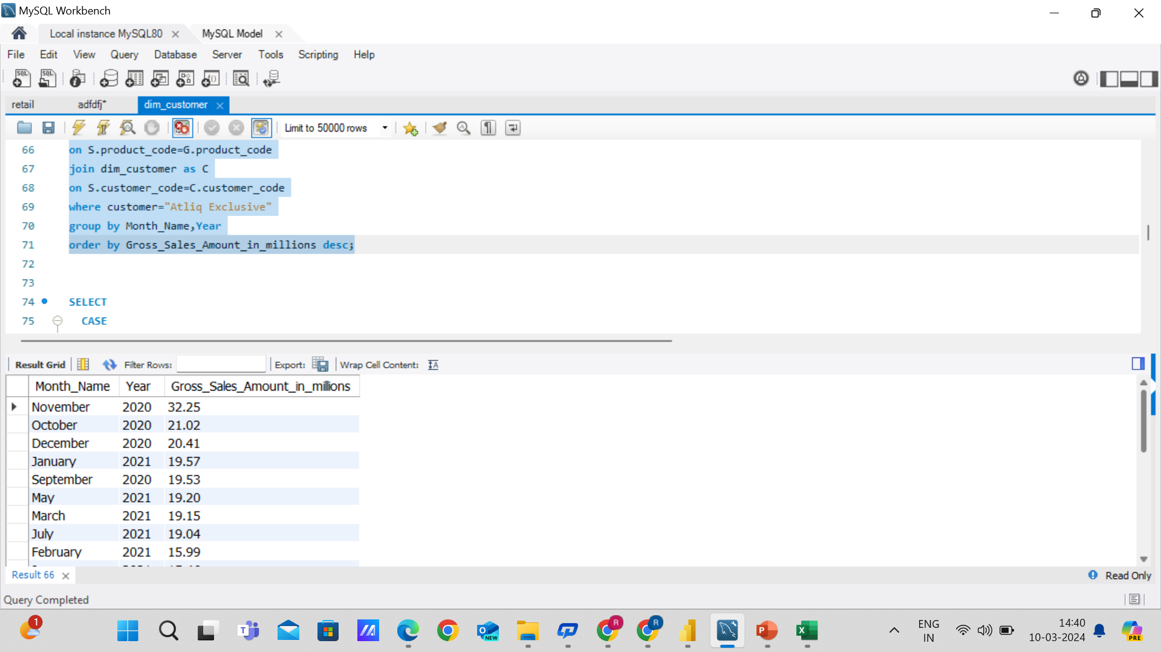
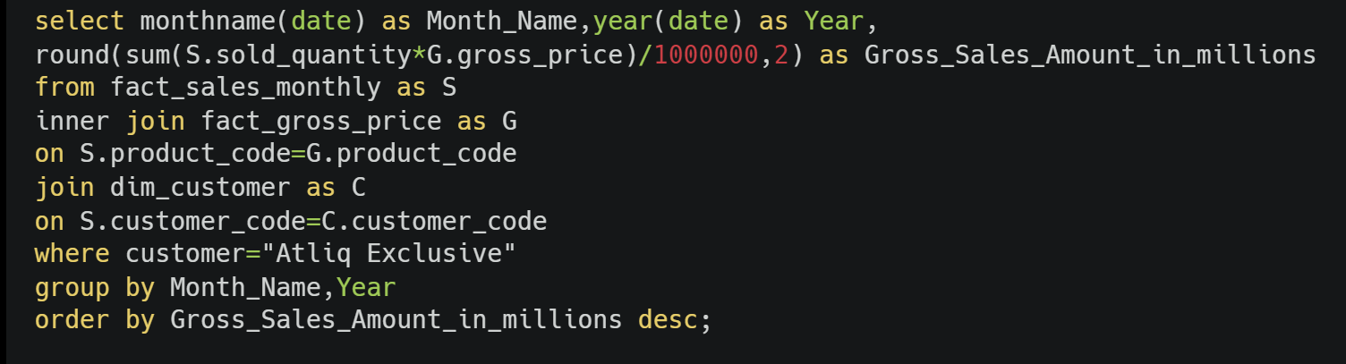
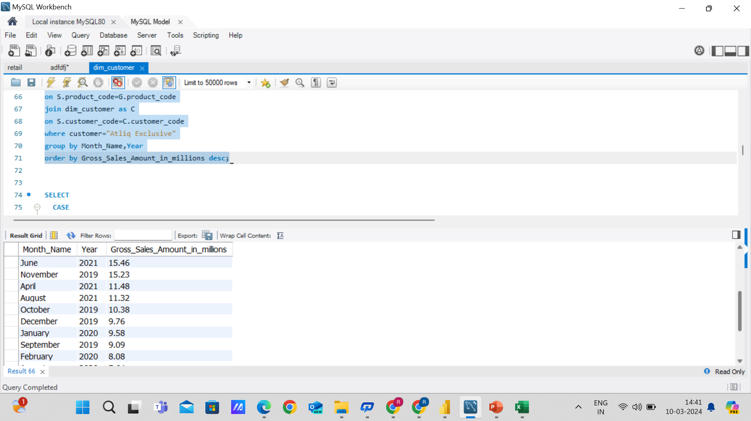
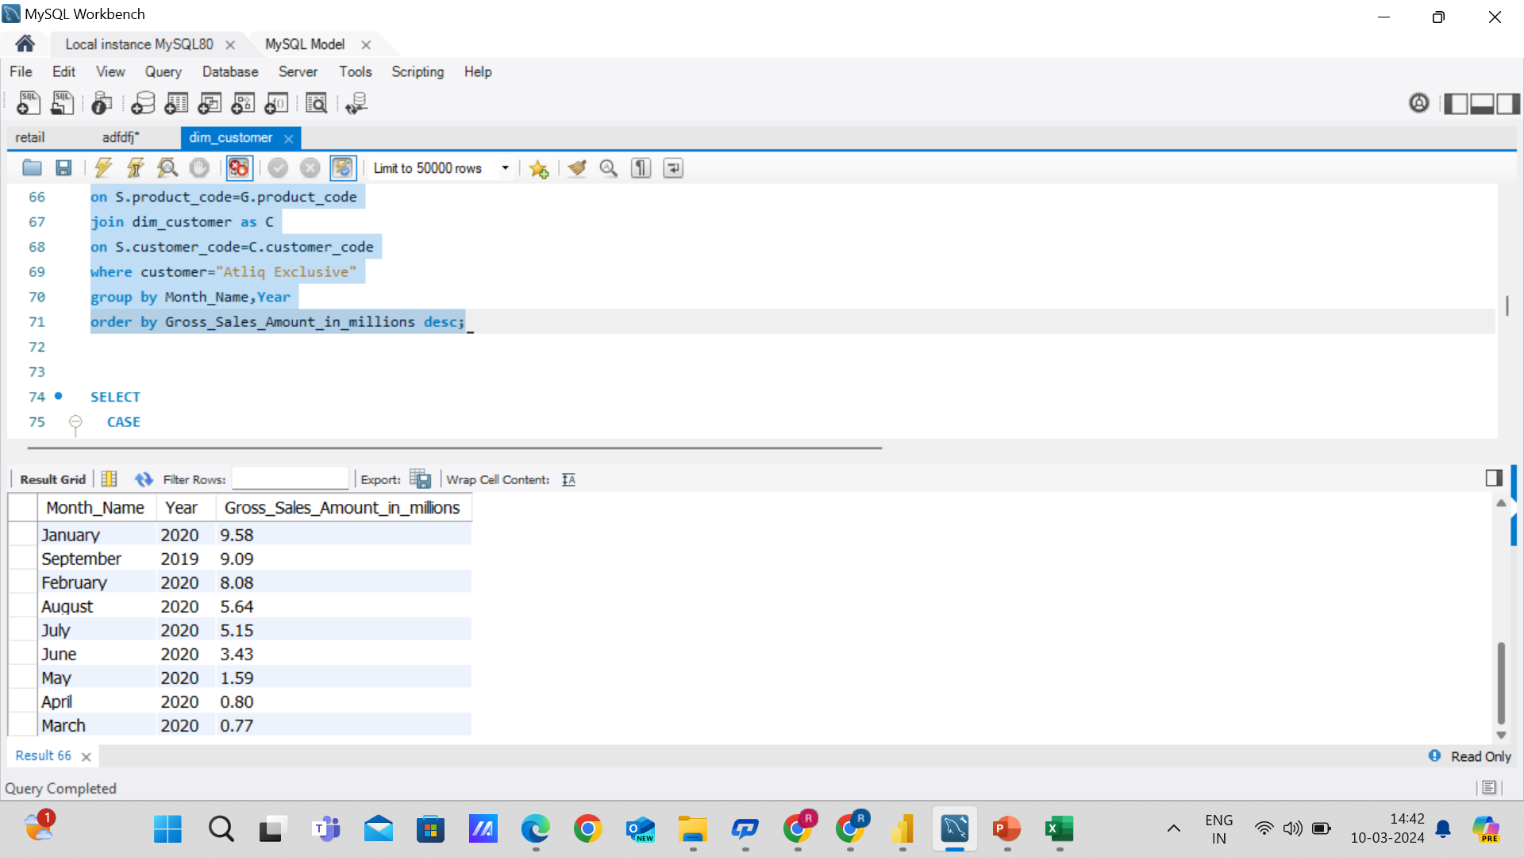
. Get the complete report of the Gross sales amount for the customer “Atliq Exclusive” for each month. This analysis helps to get an idea of low and high-performing months and take strategic decisions. The final report contains these columns: Month ,Year, Gross sales Amount

Slide 17
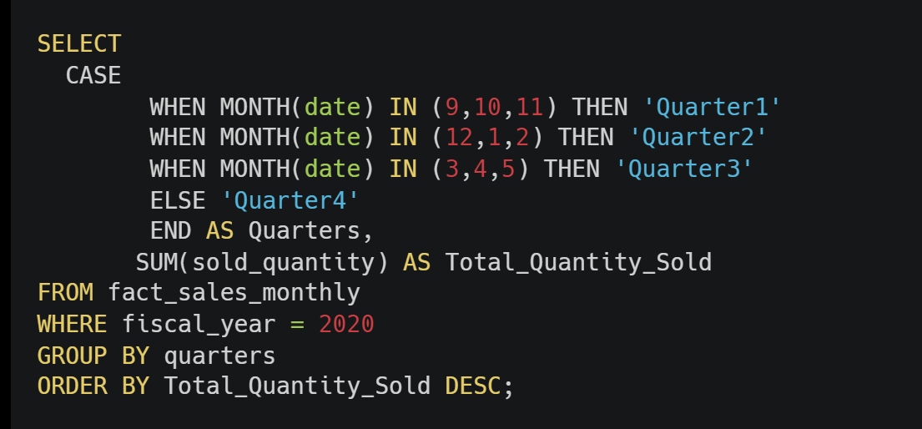
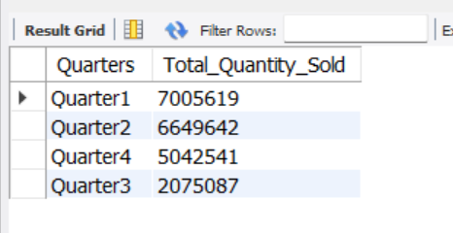
In which quarter of 2020, got the maximum total_sold_quantity? The final output contains these fields sorted by the total_sold_quantity, Quarter total_sold_quantity

Slide 18
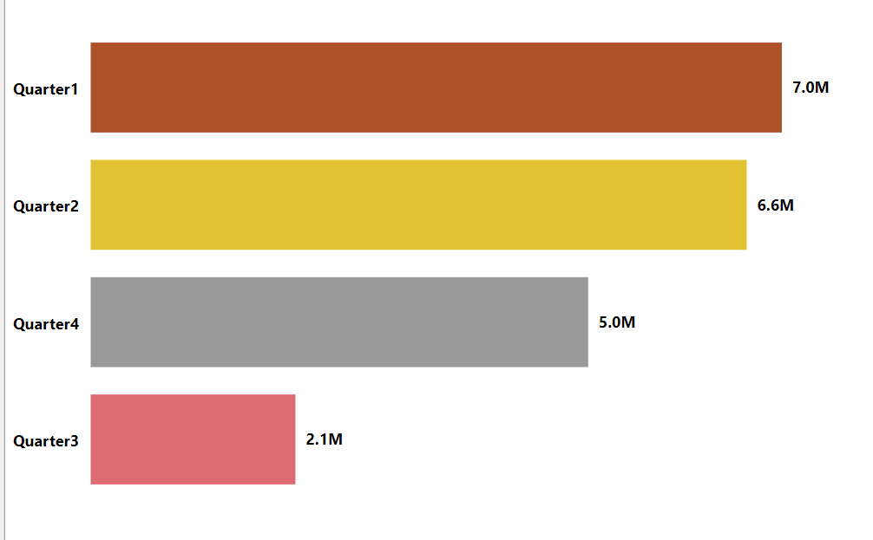
Q1( September-November) had the maximum quantity sold for FY 2020
Sales dropped in Q3( March-May)
Increased in sales recorded in Q4(June-August)

Slide 19
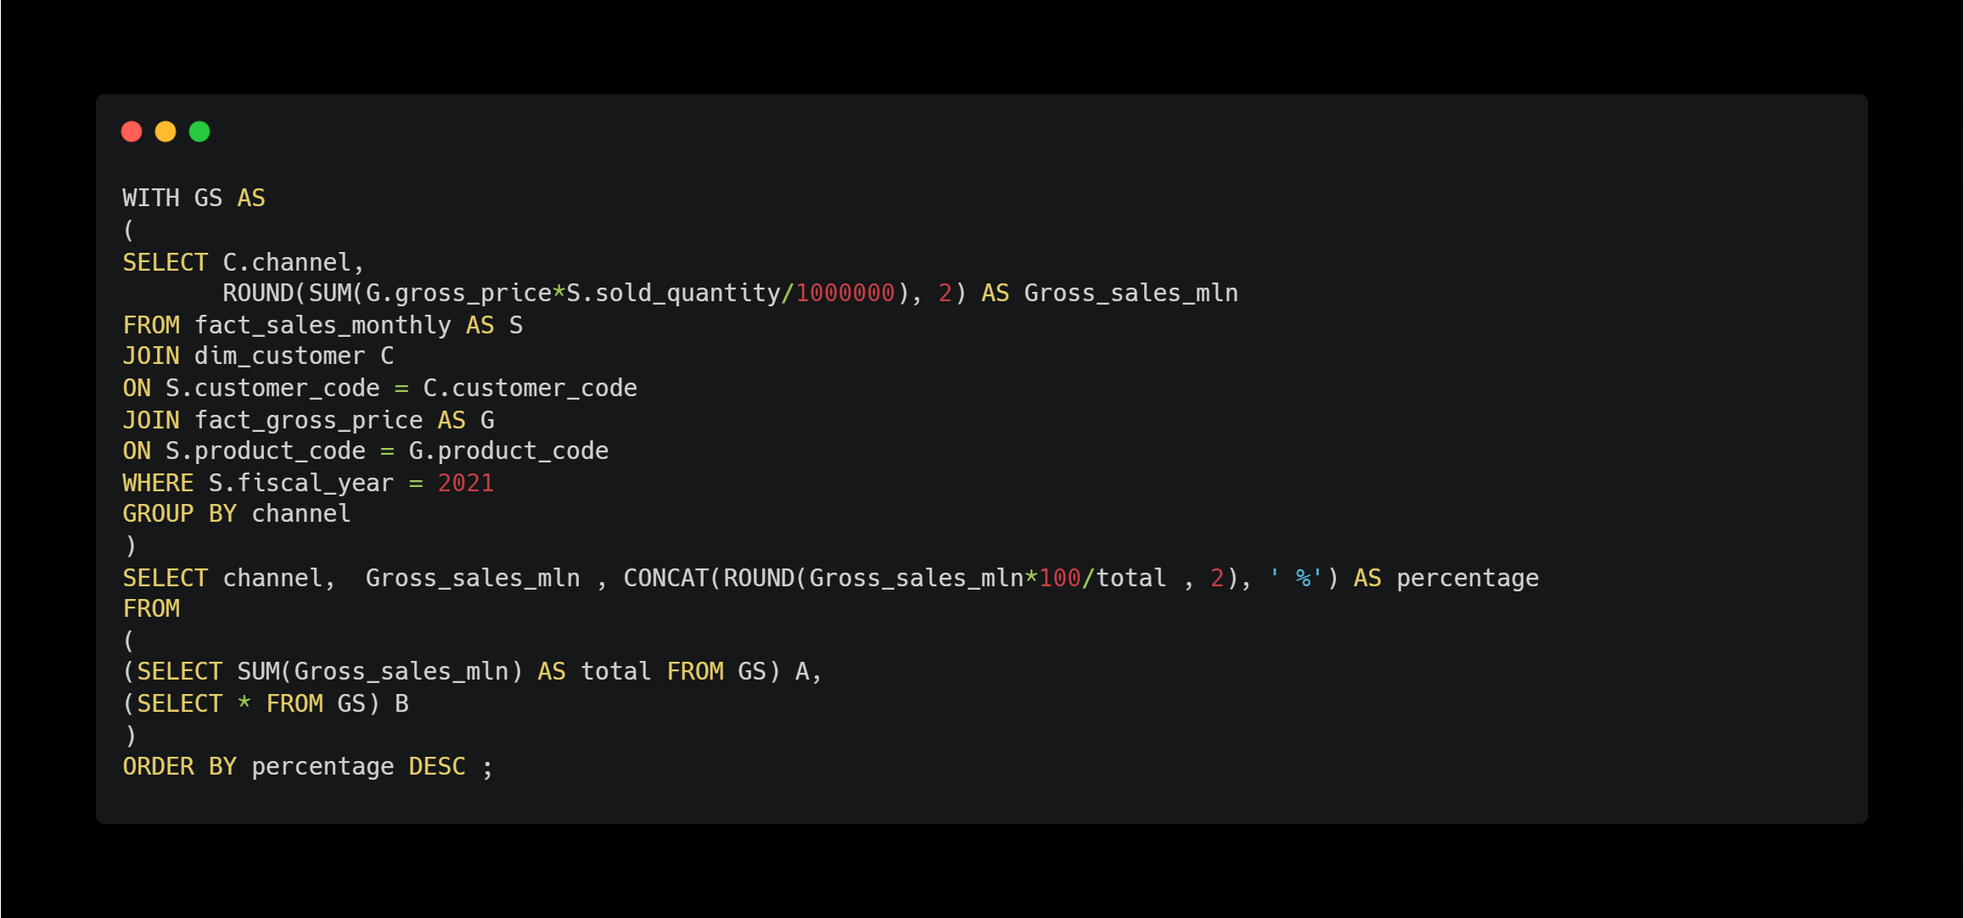
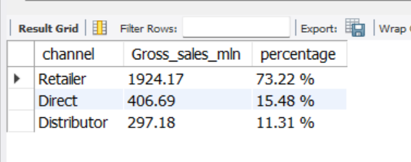
Which channel helped to bring more gross sales in the fiscal year 2021 and the percentage of contribution? The final output contains these fields, channel ,gross_sales_mln, percentage

Slide 20
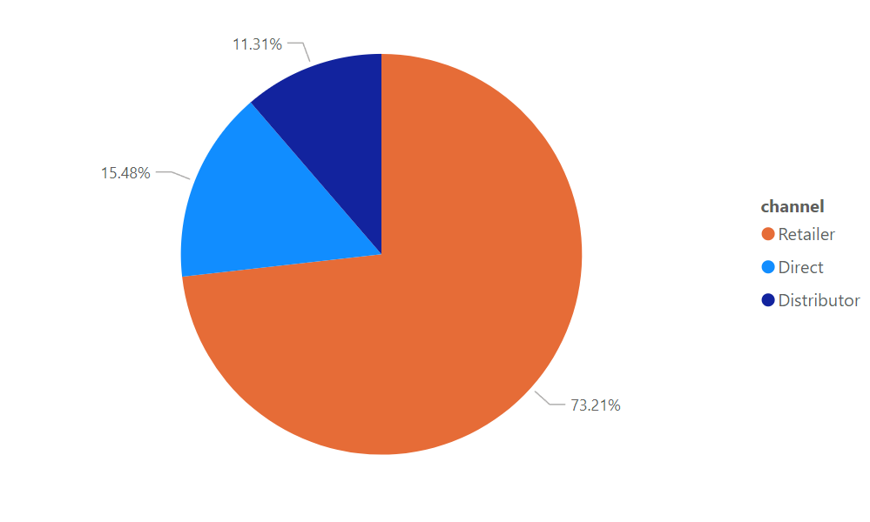
Retailers with $1219.08 Million which is 73.23% of gross sales for FY 2021
2nd is Direct channel with $257.53 Million
3rd is Distributor with $188.03 Million.

Slide 21
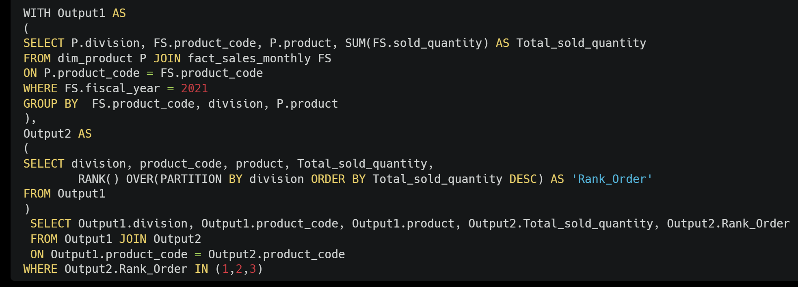
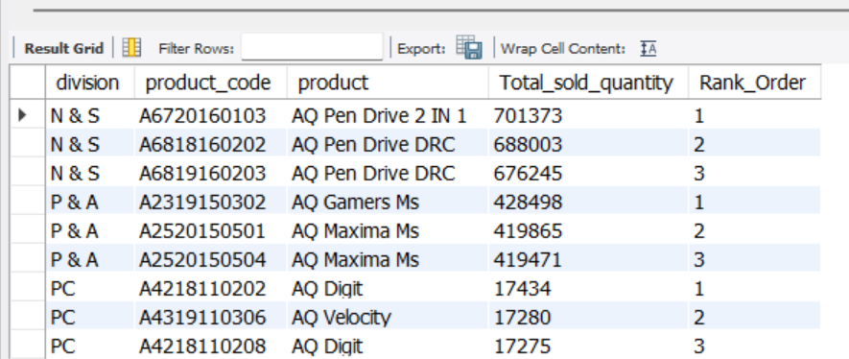
Get the Top 3 products in each division that have a high total_sold_quantity in the fiscal_year 2021? The final output contains these fields, division, product_code

